Slide 1
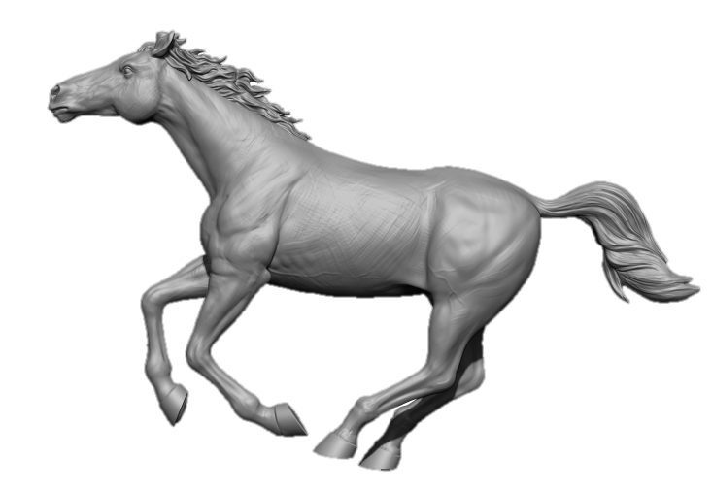
Wild Horse
Estimation

Slide 2
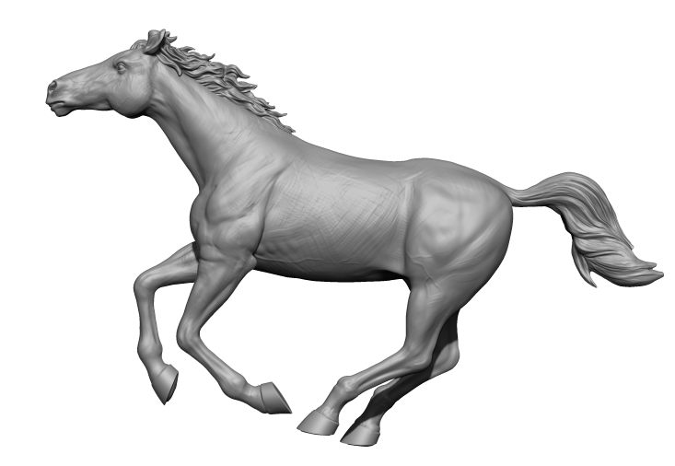
Size
1454.9 mm
57.28 inch
430.37 mm
16.94 inch
2133.59 mm
84 inch

Slide 3
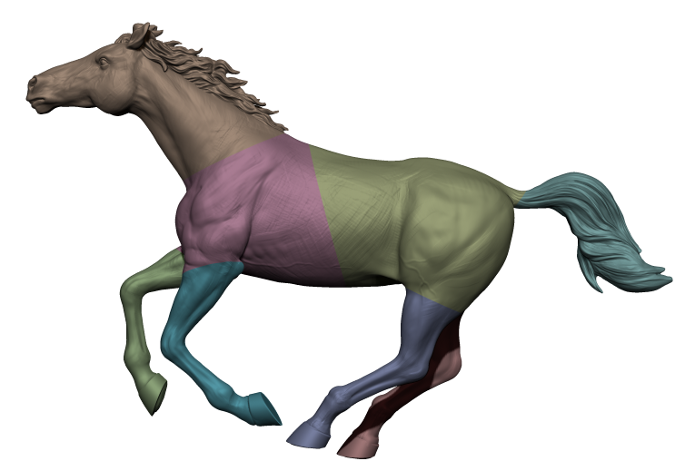
Split in to parts

Slide 4
Data
Part | Layer height | Layer width | Time | Material
Front | 1.3 mm | 4.4 mm | 3:31 hours Print simultaneously on both heads | 3.46 Kg
Back | 1.3 mm | 4.4 mm | 4:10 hours Print simultaneously on both heads | 4.24 Kg
Back left leg | 1 mm | 3.6 mm | 2:22 hours Print simultaneously on both heads | 0.695 Kg
Back right leg | 1 mm | 3.6 mm | 2:28 hours Print simultaneously on both heads | 0.767 Kg
Front right leg | 1 mm | 3.6 mm | 2:12 hours Print simultaneously on both heads | 0.615 Kg
Front Left leg. | 1 mm | 3.6 mm | 3:32 hours Print simultaneously on both heads | 0.873 Kg
Head | 0.8 mm | 3.2 mm | 16:52 hours | 2.74 Kg
Tail | 0.8 mm | 3.2 mm | 6:49 hours | 0.923 Kg
Total |  |  | 41:56, or 33:51 hours (two heads machine) | 14.24 Kg

Slide 5
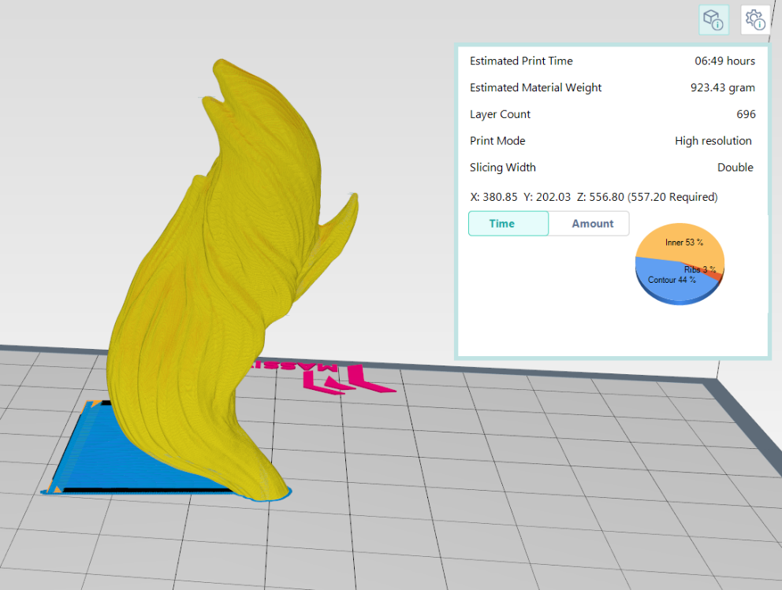
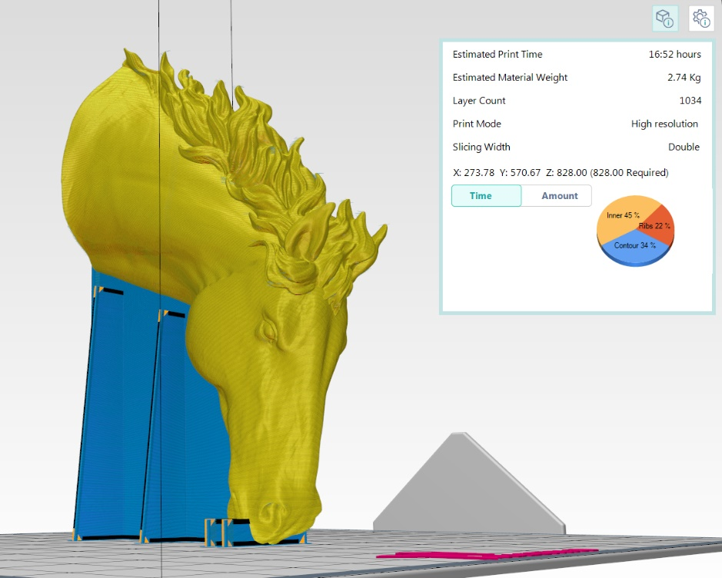

Slide 6
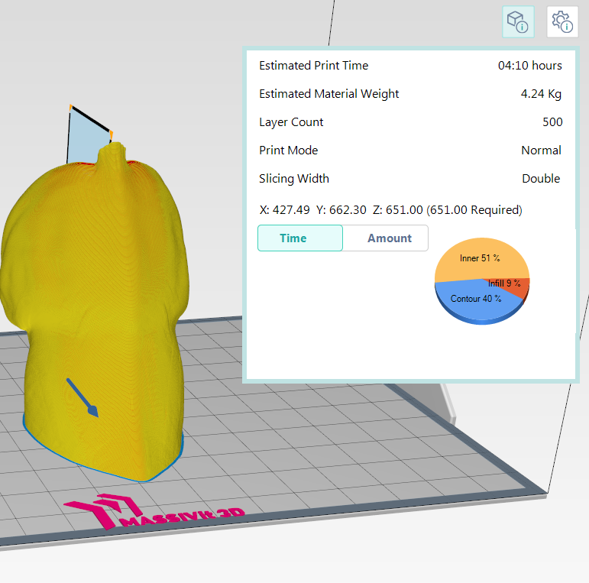
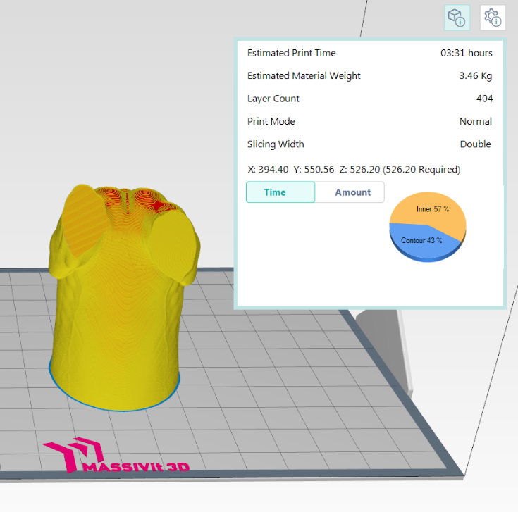

Slide 7
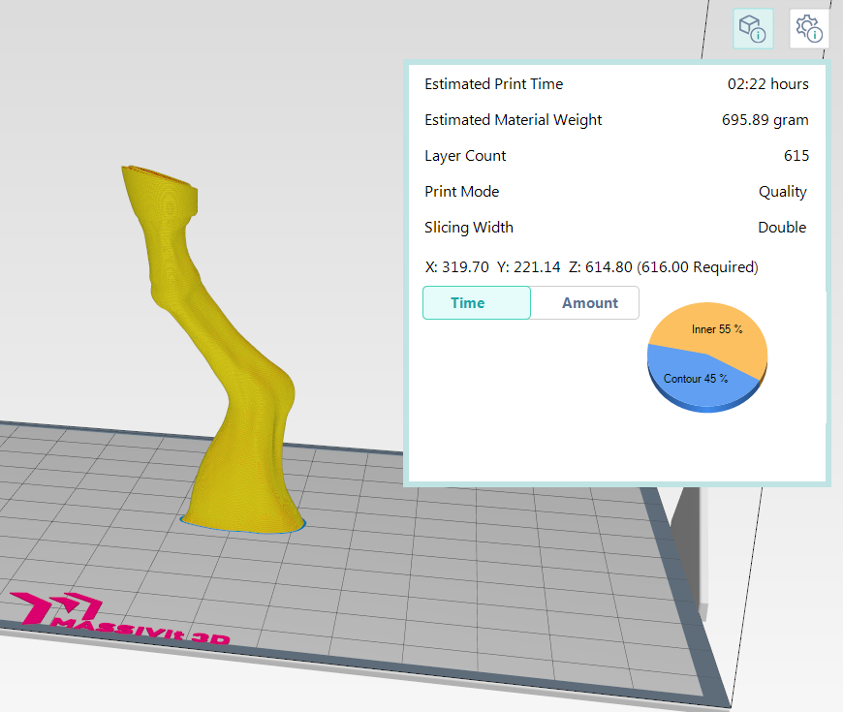
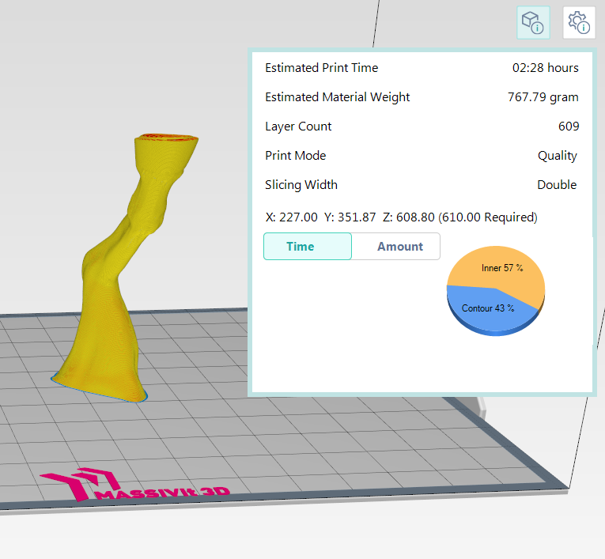

Slide 8
